Slide 1

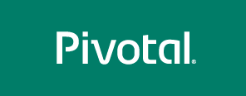
.NET Workshop
Platform Architect
Cornelius Mendoza
9/20/2017
Notes:
test
afdas

Slide 2
Agenda
Introductions and Objectives
Cloud Native Applications
.NET and Pivotal Cloud Foundry
.NET Design Considerations
.NET App Replatforming
.NET Troubleshooting Tips
.NET CI-CD Pipelines
.NET Roadmap

Slide 3
Introductions
Notes:
test
afdas

Slide 4
Cloud Native Applications
Notes:
test
afdas

Slide 5
Why do you need to be good at software?
Customers expect it.
Meet demand to operate at scale.
Gives you more business options.
Your competitors are doing it.
It makes everyone happier.
Notes:
the need to be good at software
customer UX matters
operate at scale
new business opportunities
improve EVERYONE’S satisfaction

Slide 6
Improved speed. Faster cycle time, more frequently deployments.
Improved scale. More requests per second to apps and services.
Improved stability. Greater uptime of customer-facing service.
Improved security. Achieving 100% patch coverage.
Improved simplicity. Reduce complexity of processes and tools.
Ok, but how do I know that I’m doing well at software?
Notes:
Measuring ROI

Slide 7
What are microservices?
It refers to an architectural style that supports constant change in your environment. This is accomplished by creating applications out of independent, loosely-coupled, domain-oriented services.
Notes:
Defining microservices

Slide 8
Microservices architecture | Monolithic architecture
Single focused services. | Software solves many challenges in one software package.
Loosely coupled. | Tightly coupled.
Delivered continuously. | Delivered all together, on a schedule.
Scale independently. | Scale everything together.
Independent teams own service lifecycle. | Many teams own pieces of the service lifecycle.
Emphasis on distributed systems patterns. | Emphasis on delivery and organizational processes.
Diverse technologies managed through automation. | Single, long-lived technology stacks.
Short onboarding period for new developers. | Larger codebase requires significant time to ramp up new team members.
Notes:
Monoliths aren’t BAD
Challenges when it comes to scaling, making and shipping changes, onboarding new people, coordinating parallel dev efforts, long term commitment to a given tech stack

Slide 9
Do you have a pressing reason to do it?
Can you rearrange your teams?
Are you ready to decompose your monoliths?
How will you decompose?
Are you currently doing CI / CD?
Is your production environment automated?
How will you discover services at runtime?
What can you do to prevent cascading failures?
Are you ready to evolve your data platforms?
Do you need to modernize your messaging and event stream processing toolchain?
Are you ready for modern logging, monitoring?
Moving to microservices? Here’s what to consider.
Notes:
New challenges
Where to store shared info, how to track everyone,

Slide 10
What is “cloud-native” all about?
This is an approach to building and operating software that takes advantage of the cloud-computing model. Often seen as a combination of microservices, continuous delivery, containers, and DevOps.
Notes:
Defining “cloud native”
Not about where, but HOW you build and run your app.

Slide 11
Most cloud-native applications comply with the 12 factor criteria.
One codebase tracked in version control
Explicitly declared dependencies
Configurations stored in the environment
Backing services treated as attached resources
Separate build, release, and run stages
Apps executed as stateless processes
Services exported via port binding
Scaled out via more processes
Fast startup and graceful shutdown
Parity among dev, staging, and production environments
Logs treated as event streams
Admin tasks run as one-off processes
Notes:
12 factor apps
https://12factor.net/

Slide 12
Cloud Native
Microservice architecture
API-first design
There’s a maturity model on your way to cloud native.
Cloud Resilient
Designed for failure
Apps unaffected by dependencies
Proactive failure testing
Metrics and monitoring baked in
Cloud agnostic runtime
Cloud Friendly
Twelve factor app
Horizontal scalable
Leverage platform for HA
Cloud Ready
No file system dependency
Self contained application
Platform managed ports/address
Consume off-platform services
Notes:
Maturity model.
Typically infrastructure independent, automated scaling, loosely coupled, in DevOps orgs, modern security approach

Slide 13
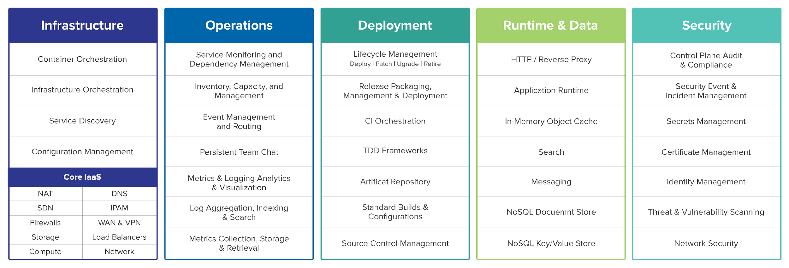
So, what actually makes up a cloud-native platform?
Notes:
What makes up a platform? What exactly is Cloud Foundry?

Slide 14
.NET and Pivotal Cloud Foundry
Notes:
Aka.. Why deploying Windows applications is painful….

Slide 15
Here’s my code…
Run it in the cloud…
I don’t care how.

Slide 16
Deploying .NET applications? It doesn’t have to be terrible.
Traditional .NET deployment on VMs | Pivotal Cloud Foundry
Provision a VM Configure IP, DNS Configure firewall Windows updates, reboot… Install IIS Deploy application Configure app pool Configure SSL Configure load balancer | ~$ cf push
Notes:
Now scale your app. I’ll wait.
Go get another VM, figure out if it has what you need, duplicate your web server configs, update the LB, open up firewalls. Will you EVER scale down?
Still have to go package your code into an MSI, performing rolling upgrades, get code onto machines, run scripts, etc.

Slide 17
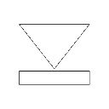




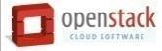

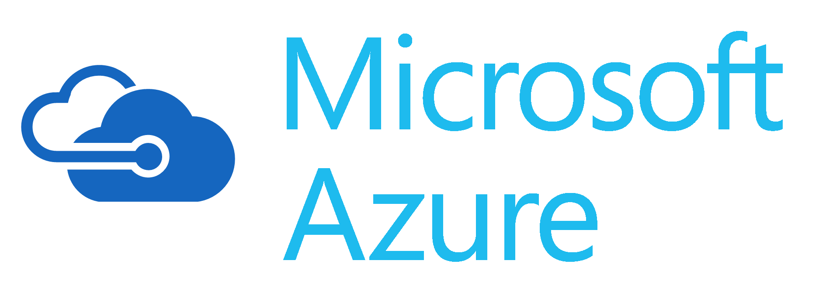
Platform Runtime - Cloud Foundry
Services
HA Proxy LB
Service Broker
Dynamic Router
Service Nodes
App Manager UI
Cloud Controller
CC-Bridge
Service
Application Manager
UAA
Login Server
Diego
Service Broker
Auctioneer
BBS
Service Nodes
Windows
Cell
Rep
Linux
Cell
Rep
CLI – Cmd Line
Service
Terminal Window
Executor
Executor
Service Broker
+
=
Service Nodes
Messaging (NATS)
Service
Metrics Collection
App Log Aggregator
Notes:
CF Architecture deep dive slide

Slide 18
Built for multi-tenancy
Push code or containers
Application manifests written in YAML
Injects environment variables
Aggregates app logs, correlates with metrics
Monitors app health, reacts
Scale manually or automatically
Built in data services, marketplace
Manages apps and underlying VMs
Natively runs on multiple IaaS platforms
Four layers of high availability built in
Access via GUI, REST API, CLI
Dev GUI = Applications Manager
Ops GUI = Operations Manager
Things about Pivotal Cloud Foundry you should know.
Notes:
4 layers – app (container), process, VM, rack or data center

Slide 19
Cloud Foundry Command Line
Notes:
Aka.. Why deploying Windows applications is painful….

Slide 20

Code Complete & Tested
Find available hosts
Install & configure runtime
Install & configure middleware
Pull application source code
Retrieve dependent libraries
Create application package
Install, configure dependent service(s)
Deploy container to host(s)
Load environment variables
Configure load balancer
Configure firewalls
Update service monitoring tools
Configure log collector
45
seconds
later
~$ cf push
Application in Production

Slide 21
> cf push my-net-app -b hwc_buildpack -s windows2012R2
or
> cf push my-core-app -b dotnet_core_buildpack
Notes:
Cf push

Slide 22
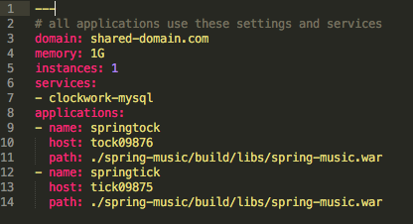
Define application metadata in a manifest file.
Application manifests tells cf push what to do with applications
What OS stack to run on: Windows or Linux
How many instances to create and how much memory to use.
Helps automate deployment, specially of multiple apps at once
Can list services to be bound to the application
YAML format – http://yaml.org

Slide 23
Stem Cells and Buildpacks
Notes:
Aka.. Why deploying Windows applications is painful….

Slide 24
Deploy source code that the platform containerizes for you
or
Deploy container images that you build yourself
Notes:
How Cloud Foundry supports containers as a deployment unit (vs buildpacks)

Slide 25
Deploy source code that the platform containerizes for you
or
Deploy container images that you build yourself
Cloud Foundry
push source code
Developer
Cloud Controller triggers staging
Diego creates container
Diego lays down buildpack, source code
Diego mounts root file system
Diego builds and uploads droplet
Diego schedules containers onto Cells
Running app!
Notes:
How Cloud Foundry supports containers as a deployment unit (vs buildpacks)
When staging complete the output consists of metadata from the buildpack and a droplet, which is an archive of files that should be layered on top of the Root Filesystem. Cloud Controller asks Diego to launch instances of the application. Diego does this by scheduling containers on the Cells.
File System: The running application container contains the Root Filesystem and a copy of the application droplet.
Metadata: Cloud Controller provides Diego with metadata to launch the correct process within the Cloud Foundry Container Environment and to monitor the process’ health.

Slide 26
Deploy source code that the platform containerizes for you
or
Deploy container images that you build yourself
Cloud Foundry
Push Docker image
Developer
Cloud Controller triggers staging
Diego spins up container to get metadata
Generate and upload image
Developer
Diego schedules container onto Cells
Cloud Controller stores metadata
Create Dockerfile
Developer
Running app!
Identify base Docker image
Developer
Package source code
Developer
Notes:
How Cloud Foundry supports containers as a deployment unit (vs buildpacks)
After the metadata arrives, Cloud Controller asks Diego to launch instances of the application. Diego does this by scheduling containers on the Cells.
File System: Garden will download and cache the Docker image layers. It will then mount these layers into the Container file system. Some of the code that Garden uses for this process is shared code that is also used with Docker/OpenShift. Note that Garden will only download layers that have not been cached.
Metadata: Cloud Controller provides Diego with metadata to launch the correct process within the Cloud Foundry Container Environment and to monitor the process’ health.

Slide 27
Stem Cells a.k.a. Stacks
Stem Cells provide the underlying OS and file system for the applications being deployed
Stem Cells are also referred to as Stacks in the command line
Two types are available for .NET applications
Windows 2012 R2
Trusty Linux

Slide 28
Anatomy of a Windows 2012R2 Diego cell
BOSH Agent
Diego Rep
Garden-Windows
Most of the components on a Windows Diego cell are the same as a Linux cell.
In fact, except Garden-Windows, Windows and Linux release code is hosted in the same source repo, and with the exception of a few dependencies, is just cross-compiled to run on Windows.
Metron Agent
Garden Server
Consul Client
Containerizer
Local Route Emitter
IronFrame
Windows Features (.NET, HWC, ASP)

Slide 29
Buildpacks for .NET
hwc_buildpack
Used with Windows 2012 R2 stem cell
Supports .NET Framework 4.5+
.NET Framework is installed on stem cell
dotnet_core_buildpack
Used with Linux stem cell
Supports .NET Core 1.0+
.NET Framework is installed by the buildpack

Slide 30
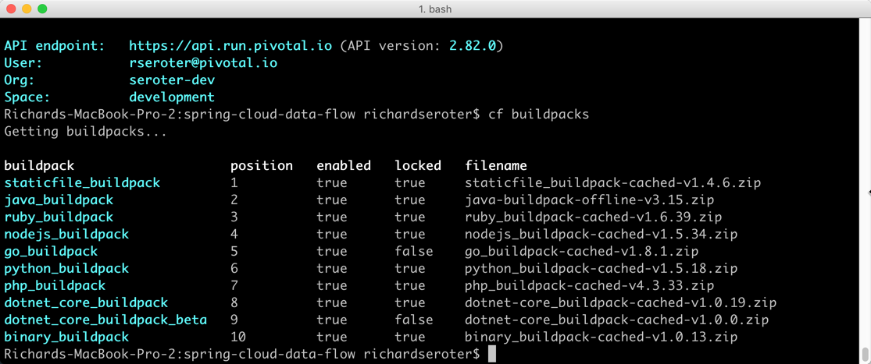
Buildpacks are prioritized and requires lifecycle management with a defined CI/CD process

Slide 31
Stacks and Buildpacks
Stack
windows2012R2
cflinuxfs2
.NET Platform
buildpack:
hwc_buildpack
.NET 4.x
N/A
buildpack:
binary_buildpack*
or
custom
buildpack:
dotnet_core_buildpack
.NET Core
* Requires .NET Core runtime to be installed on the Windows 2012 R2 stem cell or via a custom buildpack for applications requiring dotnet.exe

Slide 32
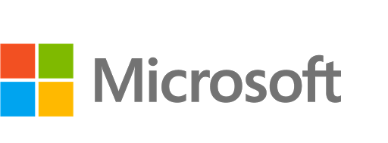
Resulting container image at runtime
Buildpack
gardenClient.StreamIn
Droplet
.NET Modules
Application
Utilities
App Staging
Windows Features (.NET, HWC, etc.)
User config
Windows Server Core container base image
Windows Server Container

Slide 33
Pushing apps to Cloud Foundry
> cf push
That’s it?
THAT’S IT!

Slide 34
Lab 1:
PCF Basics
Notes:
test
afdas

Slide 35
Break

Slide 36
.NET Design Considerations
Notes:
test
afdas

Slide 37
Writing Twelve Factor ASP.NET Applications
Avoid in-process session state*
For ASP.NET override MachineKey in web.config and on ASP.NET Core avoid persisting keyring to filesystem*
On ASP.NET avoid environment specific configuration in web.config
Avoid Integrated Windows Authentication
Avoid the GAC
Avoid custom IIS handlers
Avoid anything that uses the Windows registry
Avoid libraries that depend on DPAPI
Avoid using local disk for storing application state*
Avoid using any Windows specific or disk based logging*
Avoid any 32-bit specific libraries or libraries that can’t be bin deployable*

Slide 38
Using Environment and Runtime Variables
Notes:
test
afdas

Slide 39
Web.Config versus PCF Variables
The use of PCF environment variables is not required
.NET applications will continue to use the web.config for providing runtime information
Sensitive information supplied at deployment time by environment
Updating the web.config will require a code push and a restart of the application

Slide 40
Why use PCF Environment Variables?
Minimal coding impact – depending on .NET version and application type
Can refactor .NET applications to use the web.config if environment information is not available or defined
Sensitive information can be supplied at any time by environment
Updating the PCF environment variables does not require any new code to be pushed or a restart of the application

Slide 41
Using Logging on Cloud Foundry
Notes:
test
afdas

Slide 42
Logging with PCF
Easy to use logging functionality that is designed for handling multiple application instances out of the box
Pushing information into the log can be accomplished with a Console.Writeline() call
Stdout is captured by PCF for all .NET application types
Third-Party logging tools can be used with PCF logging by redirecting the log output to the console
To retain logging information, PCF logs should be drained into a repository designed to hold long-term logging information (i.e. Splunk)

Slide 43
Using File Access on Cloud Foundry
Notes:
test
afdas

Slide 44
Handling File Access
Avoid dependencies on the local file system
Use Cloud or Network Storage if possible
Mounting file shares are not supported with the Windows 2012R2 stem cell

Slide 45
Using Single Sign-On on Cloud Foundry
Notes:
test
afdas

Slide 46
Single Sign-On
Pivotal SSO Service provides a common integration point for .NET applications
Integrates with ADFS and Active Directory
OAuth framework for .NET applications
OIDC integration with Azure AD and other OIDC providers (v 1.12)
Visual Studio can automatically provide the basic security scaffolding
ASPNET Security model using SQL Server
Built-in support for OAuth and Open ID Authentication in .NET

Slide 47
Application Replatform for .NET
Notes:
test
afdas

Slide 48
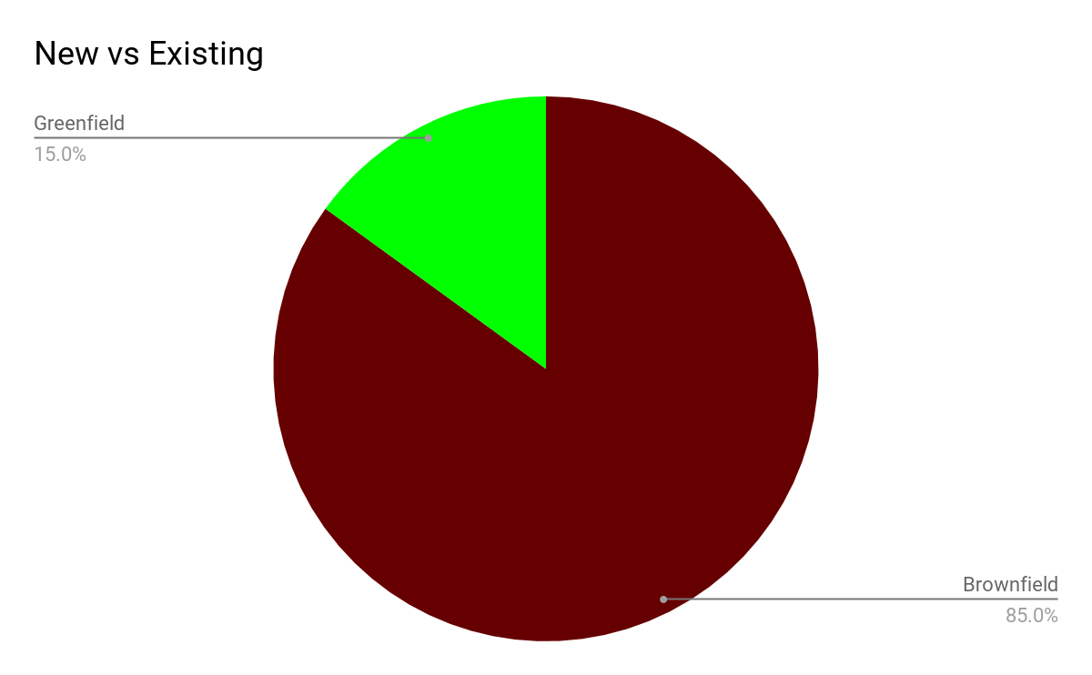
Moving to Cloud
Will my legacy apps run?
How much refactoring I need to do to make it work?
Can I leverage new features / patterns in my old apps?
How can I improve my apps over time?

Slide 49
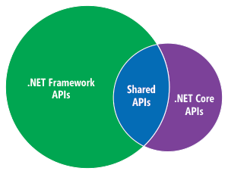
.NET Framework vs .NET Core
.NET Core can be considered a rewrite than evolutionary upgrade
.NET Framework has a larger API footprint - a lot of API was removed / changed in .NET core to break bonds on Windows
Refactoring code from .NET Framework to .NET Core for real projects is usually non trivial
.NET core opens up a lot of new possibilities including smaller footprint, simplicity, speed, and cross platform portability

Slide 50
Why Choose Core?
Up to 10x performance improvement
Improved portability of source code
Does not require a Windows Stem Cell
Reduce licensing cost for Windows Server
Reduce support and maintenance cost of supporting traditional Windows based deployments

Slide 51

Where are my favorite toys?
Large number of third party libraries are not supported
Microsoft’s own popular libraries are incomplete
EntityFramework Core
SignalR
Framework Class Library API is smaller/different

Slide 52

Should I use .NET core
or
.NET Framework?

Slide 53

You can...
Write apps using features from .NET core and run them on .NET Framework
Use existing libraries where needed
Future proof your code

Slide 54
Application Considerations
How should we handle database migrations?
Do you understand what may happen if multiple instances of the application spin up in random order?
How do we handle application recovery?
What happens when a blue/green deployment occurs?

Slide 55
Greenfield
Greenfield apps should be built as .NET Core applications
Target CLR should be defaulted to .NET Core
If need to use library or feature only available in .NET Framework, switch TargetFramework to net462*
* Non-web .NET Core applications only - .NET Core 2.0 should provide additional library support

Slide 56
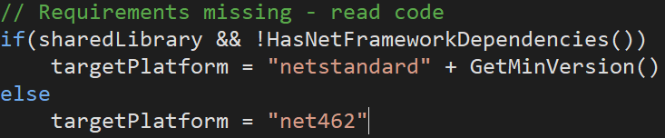
Brownfield
* Start using .NET Core libraries in your .NET Projects

Slide 57
Windows Services
Long running processes that allow execution in the background that is installed on a Virtual Machine or Physical Server
Can typically be re-platformed into a console application
Pushed to PCF as an executable with binary buildpack and start command
Routes are not used for console applications
Use process or none for healthcheck type
Scalability and High Availability without spinning up additional Virtual Machines or Physical Servers

Slide 58
Tasks and Jobs
Tasks can be used to execute an application as a one time job
Tasks run for a finite amount of time, then stop
Use for database migrations, batch jobs, rebuilding indexes, etc.
Containers are created and then destroyed as part of the execution of the task
Container inherits environment variables, service bindings, and security groups bound to the application

Slide 59
Run a task
cf run-task APPNAME “Task” --name “Taskname”
List running tasks for an application
cf tasks APPNAME
Terminate a task
cf terminate-task APPNAME TASK_ID

Slide 60
Using Services on Cloud Foundry
Notes:
test
afdas

Slide 61
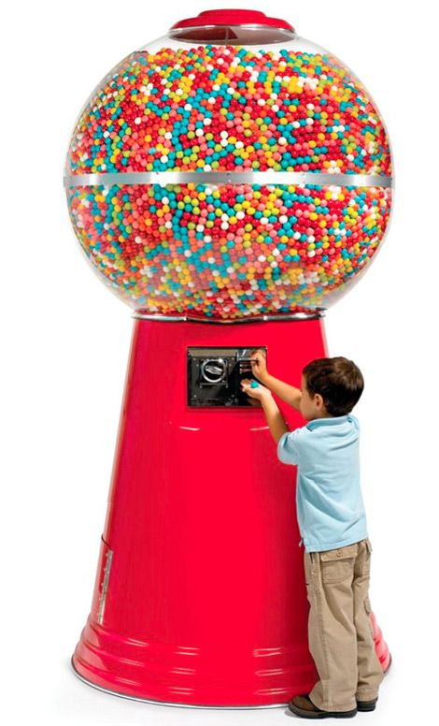
What is a Service?
Allows resources to be easily provisioned on-demand
Typically an external “component” necessary for applications
Database, cache, message queue, microservice, etc.
Can be a persistent, stateful layer

Slide 62

Types of Services
Managed - Fully integrated, with fully lifecycle management
User-Provided – Created and managed external to the platform

Slide 63
User Provided Services
Service instances managed outside of Cloud Foundry
Behave like other service instances once created
Familiar CLI commands (‘create-service’) provide service instance configuration
Example: An Oracle database managed outside of, and unknown to Cloud Foundry

Slide 64

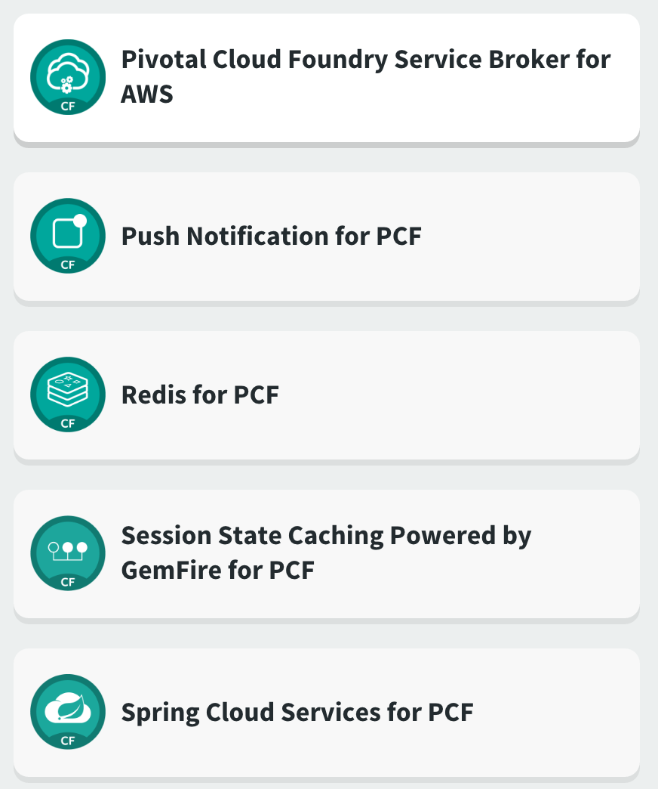
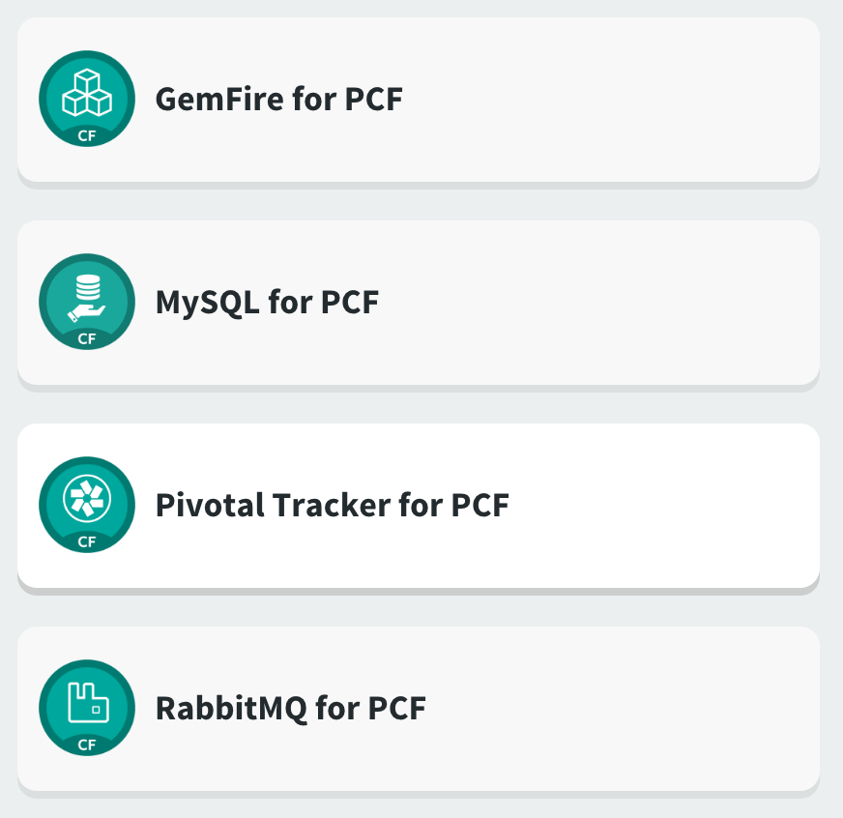
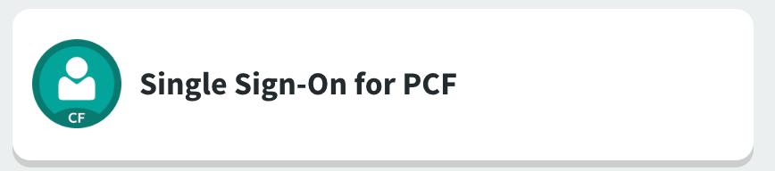
Examples of Managed Services
https://network.pivotal.io/

Slide 65
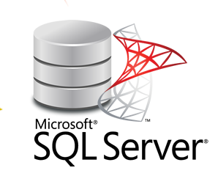
SQL Server
Can run in two security modes:
Integrated Windows: only allows use of windows credentials
Mixed mode: allows use of both windows credentials, and login/password integrated credential store inside sql server itself
Credentials don’t have to be stored in clear text inside config file
No need to transform config file

Slide 66
SQL Server - Solution
Use mixed mode with SQL Server managed credentials
Credentials are not stored in config file but injected via service binding within PCF
Clear text is not an issue. Users with access to the space where credentials are stored are already authorized to see them

Slide 67
Services cannot be refactored
Reasons:
Integrate with off-the-shelf systems
Legacy systems sitting outside of PCF
Ownership of interconnected systems outside of primary business ownership

Slide 68
Services cannot be refactored - Solutions
Proxy Facade
Wrap target system in microservice
Host where Integrated Windows Authentication works
Carry encoded kerberos token as part of JWT request
Ensure that delegation is enabled, and token allows for impersonation of credentials
Unpack kerberos token and establish impersonation context
Call downstream service

Slide 69
Messaging
Many different message broker technologies can be found in the enterprise
Microsoft: BizTalk, Azure Messaging Bus, MSMQ, WCF
Third-Party: Tibco, Oracle, IBM
Avoid trying to change messaging architectures unless the customer brings the topic up (i.e. RabbitMQ)
Products available on Marketplace that can provide a bridge between messaging protocols and clouds (i.e. Solace)
If possible, leverage User Provided Service tiles to store connection information for non-supported services

Slide 70
What is Steeltoe?
“Steeltoe brings the power of resilient, scalable microservices to .NET developers, without all the headache.”
External Configuration
Service Registry and Discovery
Circuit Breaker
Cloud Connectors
Supports .NET 4.x and .NET Core Frameworks
Additional information available at http://steeltoe.io

Slide 71
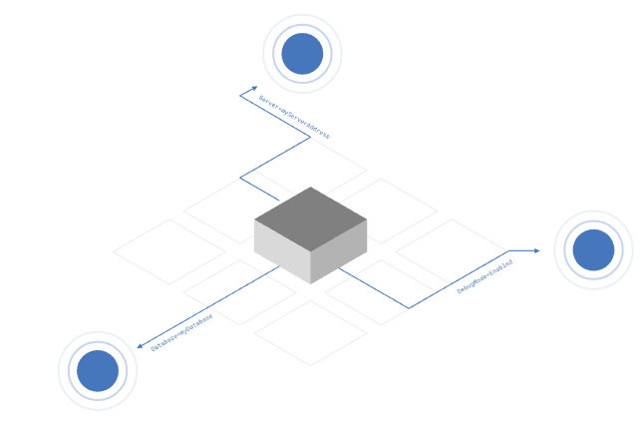
Configuration Providers
Cloud Foundry
VCAP_APPLICATION, VCAP_SERVICES, CF_*
Config Server
Access config stored in Spring Cloud Config Server (backed by Git, Vault, local filesystem)
Across all instances, all apps, all environments
Notes:
We build on the Configuration API provided by .NET which enables you to pull values from different sources using Configuration Providers.
Each provider supports reading a set of name-value pairs from a different source location; adding them into a combined multi-level configuration dictionary.
Out of the box, .NET supports getting configuration from:
Command-line arguments
File sources (e.g. JSON, XML and INI)
Environment variables
Custom providers
Steeltoe adds two additional providers to that list:
Cloud Foundry Provider
This provider enables the standard Cloud Foundry environment variables, VCAP_APPLICATION, VCAP_SERVICES and CF_* to be parsed and accessed as configuration data.
Config Server Provider
This provider enables the Spring Cloud Config Server to be used as a source of configuration data for a .NET application.
Steeltoe’s configuration supports both reading the config values directly, as well as Dependency Injection with the Options framework

Slide 72
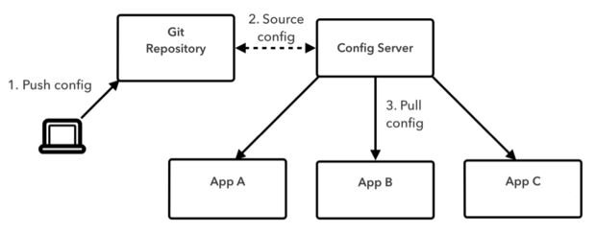

About Spring Cloud Config Server
Notes:
Spring Cloud Config Server is a service that gives you a central place to manage an application’s configuration values externally across all environments.
As an application moves through the deployment pipeline from development to test and into production, you can use the config server to manage the configuration between environments and be certain that the application has everything it needs to run when you migrate it. The config server easily supports labeled versions of environment-specific configurations and is accessible to a wide range of tooling for managing its content.
1. Save your configuration (represented as YAML) to a Git repo (also supports Hashicorp Vault, Subversion or local storage)
All changes to config are versioned and auditable
2. When the server comes online it pulls the latest config values
3. When your app comes online it pulls the latest config values
Today, it doesn’t support automatic push of updated app config when the repo changes, only pull

Slide 73
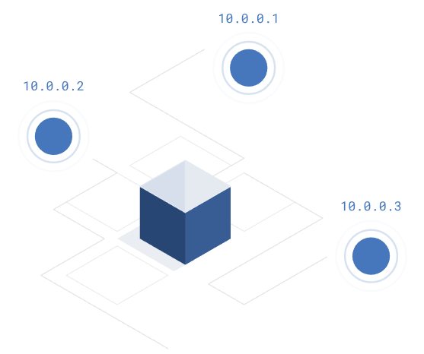
Service Discovery
Service Discovery Client
.NET client for Netflix Eureka
Implements Service Discovery design pattern
Dynamically discover and call registered services
Release 1.1 Supports C2C Networking, IP Address as Service Address
Notes:
As services scale in and out, you need a way to look up instance addresses.
Trying to hand-configure each client of a service or adopt some form of access convention can be difficult and prove to be brittle in production. Instead, applications can use a service registry to dynamically discover and call registered services.
There are several options to choose from when implementing the Service Discovery pattern. Steeltoe has initially chosen to support one based on Eureka; using Netflix’s Service Discovery server and client.

Slide 74
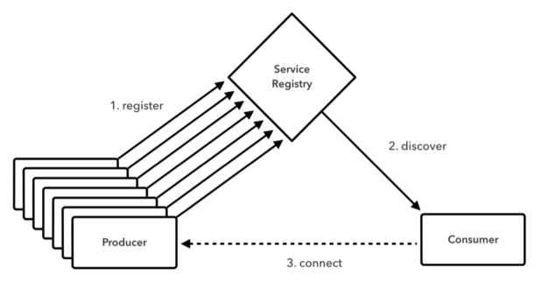
About Eureka Server
Notes:
1. Microservices register themselves when they come online (due to deploy, scaling, etc.)
Then the Eureka Server periodically checks in to make sure they’re still alive and keeps it’s server list up-to-date
2. When a consumer comes online, it first pulls the server list from the Eureka server and then gets periodic updates conforming the current state
3. Then your application can make calls to microservices it depends on, even when they’re ephemeral, dynamically addressed, scaling out and in, etc.
It’s built to be HA so that if the Eureka server becomes unavailable, the consumer works from a local clone until the server comes back online.

Slide 75

Circuit Breaker
Circuit Breaker Client
.NET implementation of Netflix Hystrix
Bypass failing services with elegant fall-back behavior (so your users don’t see nasty error messages)
Rich metrics and monitoring
Available in Steeltoe 1.1

Slide 76
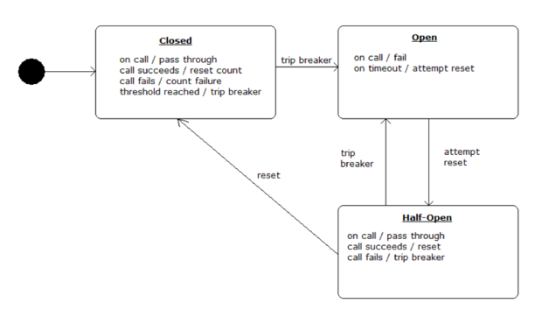
About Hystrix

Slide 77
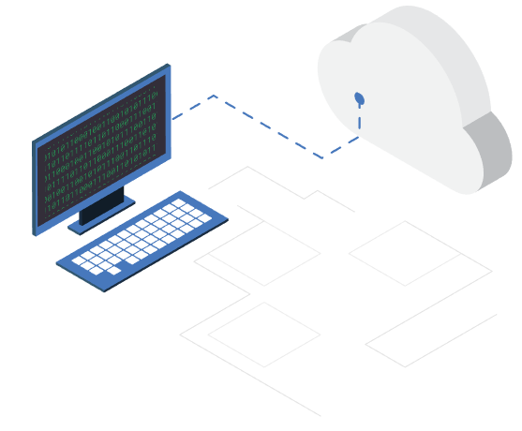
Cloud Connectors
Connectors for common data services
MySQL
Postgres
Redis
RabbitMQ
OAuth (for UAA or Pivotal Single Sign-on)
Notes:
Steeltoe Connectors simplify the process of connecting to and using backing data services on Cloud Foundry.
They provide out-of-the-box support for discovering many common services on Cloud Foundry.
They also include the ability to use settings-based configuration so developers can supply configuration settings at development and testing time, but then have those settings overridden when pushing the application to Cloud Foundry.

Slide 78

Security Providers
OAuth2 SSO Provider
JWT resource protection
Redis Key Ring Repository
Notes:
Steeltoe provides a number of Security related services that simplify using Cloud Foundry based OAuth2 security services in ASP.NET Core applications.
There are two providers to choose from when adding Cloud Foundry security integration:
A provider that enables OAuth2 Single Sign-on with Cloud Foundry Security services.
A provider that enables using JWT tokens issued by Cloud Foundry Security services for securing access to REST resources/endpoints.
In addition to the two providers above, Steeltoe also makes available an additional security provider which allows you to easily use a Cloud Foundry based Redis service for ASP.NET Core Data Protection Key Ring storage. By default, ASP.NET Core stores the key ring on the local file system. In a Cloud Foundry environment, this of course is un-workable and violates the twelve-factor guidelines for developing cloud native applications. Using the Steeltoe Redis Key Storage provider, you can reconfigure Data Protection service to use Redis on Cloud Foundry for storage.

Slide 79

Management Endpoints (Actuators)
Available in Steeltoe 1.1-rc3 and above
/info arbitrary app info, e.g. git build tag
/health application health information
/trace circular buffer of last 100 http requests/responses
/loggers shows and modifies configuration of loggers down to the class level
Notes:
Steeltoe helps you manage and troubleshoot your application by exposing standard (from Spring Boot) management endpoints (aka Spring Boot Actuators)
In Steeltoe 1.1 we will include these 4 endpoints that will automatically get bound to your application

Slide 80
Open Source and Flexible
Steeltoe works...
- with .NET Core and with the .NET framework
- on Windows and on Linux
- standalone and running on Cloud Foundry

Slide 81
Other Concerns
Standardized Security Framework
Single place to improve
Leverage routing services
No resources to refactor
Ongoing savings justify one-time change
Not that difficult to do
Change in culture through the entire organization

Slide 82
Troubleshooting Windows Deployments

Slide 83
Troubleshooting Windows Deployments
Currently no ability to remote debug deployed application
Don’t introduce changes until you have a running application
Watch for transformations that may happen at build or deployment time (i.e. web.release.config)
Review the web.config that is in the publish folder
Turn custom errors off in the web.config
valuable only if the application can start
provides the call stack leading to the application error
Test connection strings to check on the ability to login to services with the supplied credentials
Remote into Stem Cell to view Event Logs (if available)

Slide 84
Troubleshooting Windows Deployments
502 Bad Gateway Errors happen before the application can fully start up and usually tied to issues in the web.config (if the application runs locally)
missing files
connection issues
proxy issues
Have a clean installation of a Windows 2012 R2 IIS Server available to test running the application on a clean server
Should not be joined to a domain
If the application won’t run on the server, it will not run on PCF

Slide 85
Troubleshooting Database Access
Check access using database utilities or working applications to confirm connectivity and permissions
FQDN or IP Address must be used to access the database server over TCP
.NET Applications utilize connection strings in the web.config during runtime
Applications should still run without needing any modifications
Use the User Provided Service for connection string information if build deployments are not using token replacement
If Entity Frameworks is used in the application, there is a good possibility that the databases can be migrated to PCF MySQL
Utilize Database Migrations to seed the databases
Be aware of any back-end database triggers

Slide 86
CI-CD Pipelines using VSTS/TFS

Slide 87
CI/CD Pipelines with TFS/VSTS
Many Enterprises use Microsoft’s Team Foundation Services/Visual Studio Team Services for Source Code Management
Visual Studio Team Services 2017 is recommended for building .NET Core applications
Cloud Foundry plug-in available from Microsoft in the marketplace
Allows for easy deployment into Cloud Foundry
Automated CI/CD Pipelines can be created to push directly into PCF
Easily implement Blue/Green deployments
Some organizations use token replacement tools at deployment time to generate the login information for their connection strings

Slide 88
Building CI/CD Pipelines with TFS/VSTS
Create a free account at visualstudio.com
Install the CF Plug-in from the Marketplace
Windows CF CLI needs to be available to the build agent
Can utilize internal and external repositories for build and deployment (github.com, Jenkins, etc.)
Configure builds to use file publish methods vs installation packaging
Create the service endpoints using deployment accounts
Blue/Green Deployments easily implemented in minutes
Step-by-step Implementation Recipe/Guide is available at:
TFS/VSTS PCF CI-CD Guide

Slide 89
CI-CD Demo

Slide 90
Demo Steps
Setup Endpoints and Services
Create a Build Definition for a .NET Application
Create a Deployment Definition for a .NET Application
Execute a Build
Execute a Simple Deployment
Overview of Blue/Green Deployments using VSTS/TFS
Execute a Blue/Green Deployment

Slide 91
.NET Roadmap

Slide 92
Coming soon for .NET
PCF v 1.12
BOSH SSH for Windows Stem Cells
Event Log drain to syslog
Steeltoe v 1.1
CredHub integration
Container to Container networking for Discovery Service

Slide 93
On the Roadmap
Volume Services
Windows 2016 Container support

Slide 94
Appendix

Slide 95
PCF meets
Active Directory
Notes:
Aka.. Why deploying Windows applications is painful….

Slide 96
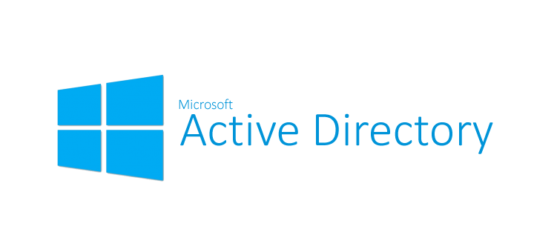
Active Directory
Used by almost every enterprise that uses Windows as their primary OS
Provides centralized management of Users, Machines, Policies
Establishes standardized authentication and authorization methods for users and applications
Extensively supported by many enterprise applications both off-the-shelf and in-house
Native SSO support via Integrated Windows Authentication
Enforce local security policies on Domain joined machines
Allow administrators to push and administer applications running on client machines
Out of the box high availability

Slide 97
Integrated Windows Authentication
Heavily used in intranet scenarios
Client identity can be automatically established from logged in windows session
Authorization is negotiated using one of two protocols: NTLM/Kerberos
Servers identity can be validated without use of certificate

Slide 98

Kerberos - High Level
Kerberos is authentication protocol
Mutual authentication of both Client and Service
Federated - relies on third party trust (Domain Controller) by both Client and Service
Requires that both client and service run under domain account
Service account must have an associated SPN known to client
SPN Format:
<service class>/<host>:<port>/<service name>

Slide 99
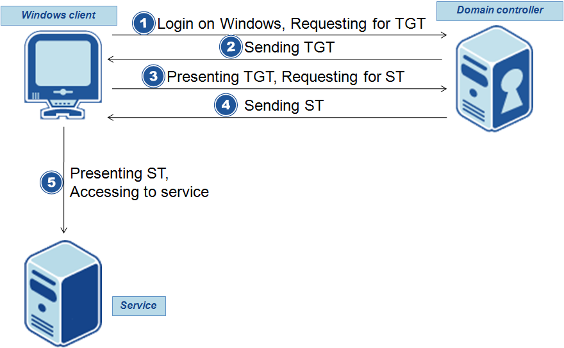
Kerberos - Deep Dive

Slide 100
IWA + PCF = Not supported
Diego Cells have to be domain joined
Application must run under specific account
SPN has to be created by domain admins
GPOs pushed on cell can break it

Slide 101
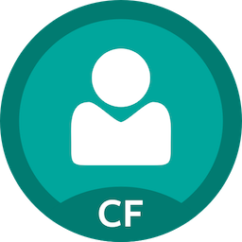
PCF with Active Directory
Out of the box STS via SSO tile
Allows authentication of Active Directory users using ADFS
Issues OAuth2 JWT tokens for authorization flows
Applications must handle OAuth2

Slide 102
“Not good enough”
We must use Integrated Windows Authentication because:
Legacy apps may not be able to leverage OAuth2 easily (WCF, WIF), rely on WS-*
Authentication to SQL Server
Need to call other services that can’t be refactored
Standardized security framework
No resources to refactor apps

Slide 103
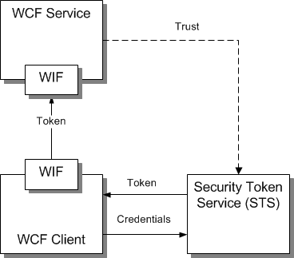
WCF+WIF
SOAP based services
Does not support OAuth2 out of the box
Token flows to outbound flows automatically if using kerberos
Security settings largely driven by extensible configuration
Extremely confusing

Slide 104
PLEASE DON’T TOUCH IT!
… LONG TIME AGO
… IN A GALAXY FAR FAR AWAY
… WE CONFIGURED THESE WCF SECURITY SETTINGS
… WE JUST COPY AND PASTE THEM AND THEY WORK
… AND WE DON’T KNOW TO CHANGE THEM

Slide 105
Typical WCF Configuration
<system.identityModel>
<identityConfiguration saveBootstrapContext="true">
<audienceUris mode="Always">
<add value="uri:pcf" />
</audienceUris>
<claimsAuthorizationManager type="DSF.Fwk.IES.IdentityModel.Authorization.IESAuthorizationManager, DSF.Fwk.IES.IdentityModel.Authorization, Version=4.0.0.0, Culture=neutral, PublicKeyToken=173a445704fe9994" />
<issuerNameRegistry type="DSF.Fwk.IES.IdentityModel.DsfIssuerNameRegistry, DSF.Fwk.IES.IdentityModel, Version=4.0.0.0, Culture=neutral, PublicKeyToken=173a445704fe9994">
<trustedIssuers>
<add url="http://localhost/Active/FederationMetadata/2007-06/FederationMetadata.xml" />
</trustedIssuers>
</issuerNameRegistry>
</identityConfiguration>
</system.identityModel>
<system.serviceModel>
<services>
<service behaviorConfiguration="serviceDSF" name="Hello.ServicePCF">
<endpoint address="uri:pcf" behaviorConfiguration="endpointDSF" binding="DSFWS2007FederationHttpBinding" bindingConfiguration="dsfWS2007FedHttp" name="endpointPCF" contract="Hello.IServicePCF" listenUri="https://localhost:44354/Service.svc" />
</service>
</services>
<bindings>
<DSFWS2007FederationHttpBinding>
<binding name="dsfWS2007FedHttp" transactionFlow="false" maxReceivedMessageSize="2147483647" sendTimeout="00:10:00" receiveTimeout="00:10:00">
<readerQuotas maxDepth="32" maxStringContentLength="2147483647" maxArrayLength="2147483647" maxBytesPerRead="2147483647" maxNameTableCharCount="2147483647" />
<security mode="TransportWithMessageCredential"> <!-- this force the HTTPS transport -->
<message issuedTokenType="http://docs.oasis-open.org/wss/oasis-wss-saml-token-profile-1.1#SAMLV1.1" negotiateServiceCredential="false" />
</security>
</binding>
</DSFWS2007FederationHttpBinding>
</bindings>

Slide 106
Typical WCF Configuration
<behaviors>
<endpointBehaviors>
<behavior name="endpointDSF">
<IES /> <!-- required for our security -->
</behavior>
</endpointBehaviors>
<serviceBehaviors>
<behavior name="serviceDSF">
<serviceMetadata httpsGetEnabled="true" />
<serviceDebug includeExceptionDetailInFaults="true" />
<serviceAuthorization principalPermissionMode="Always" /> <!--To fill the thread-->
<serviceCredentials useIdentityConfiguration="true" > <!--To activate WIF -->
</serviceCredentials>
</behavior>
</serviceBehaviors>
</behaviors>
<extensions>
<behaviorExtensions>
<add name="Internationalisation" type="DSF.Fwk.IES.ServiceModel.Configuration.InternationalizationBehaviorExtensionElement, DSF.Fwk.IES.ServiceModel, Version=4.0.0.0, Culture=neutral, PublicKeyToken=173a445704fe9994" />
<add name="IES" type="DSF.Fwk.IES.ServiceModel.Configuration.IESBehaviorExtensionElement, DSF.Fwk.IES.ServiceModel, Version=4.0.0.0, Culture=neutral, PublicKeyToken=173a445704fe9994" />
</behaviorExtensions>
<bindingExtensions>
<add name="DSFWS2007FederationHttpBinding" type="DSF.Fwk.IES.ServiceModel.Configuration.DSFWS2007FederationHttpBindingCollectionElement, DSF.Fwk.IES.ServiceModel, Version=4.0.0.0, Culture=neutral, PublicKeyToken=173a445704fe9994" />
</bindingExtensions>
</extensions>

Slide 107
WCF-WIF - Solution
Encode JWT token into SOAP header
Create custom AuthorizationManager that extracts token from header
Validate token via System.IdentityModel.Tokens.Jwt available on nuget
Extract claims from token and load them into Principal
Serialize the original JWT token as an extra claim
Attach interceptor for all outgoing WCF calls and reinject original JWT token into the SOAP header
Package as profiles via code - give them to your developers as NuGet

Slide 108
Data Protection Services & Encryption

Slide 109
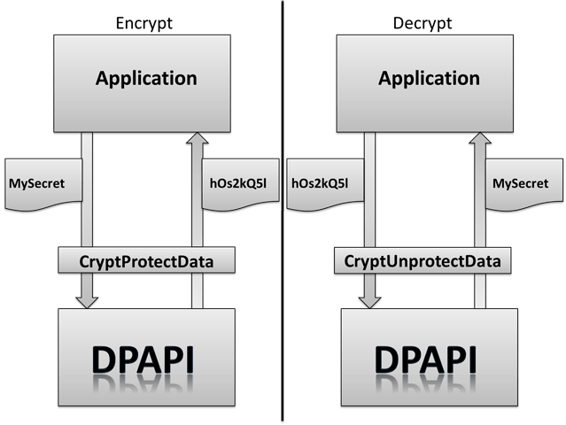
Data Protection
Provide simple and uniform API to encrypt/decrypt sensitive information
Leveraged in .NET via ProtectedData class
Relies on Data Protection API (DPAPI)

Slide 110
DPAPI
Windows only
Key management is handled automatically
Keyring is protected by user’s password hash
Relies on Triple-DES encryption
Exposed via Crypt32.dll
Stores keyring stored in user profile
%Userprofile%\Application Data\Microsoft\Protect

Slide 111

DPAPI - Not for the cloud
Keyring tied to the infrastructure
Requires specific user account
Not to be used in load balanced solutions

Slide 112
.NET Core Data Protection
Relies on RSA for cryptography
Keyring storage is configurable
File system with custom path
Redis
Registry
Azure storage
Keyring can be protected via certificate
Certificate must be installed on system
Keys stored in XML format
Usage hides key management and unlocking mechanism
Key rotation, expiration, revocation

Slide 113
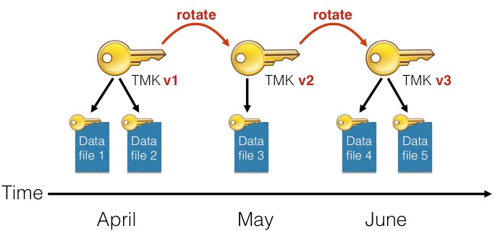
.NET Core Data Protection - Use cases
Good applications
Transient: Access Tokens
Ok applications
Permanent: Database records
Bad applications
Static: Configuration data

Slide 114

What is our goal
“Protect sensitive semi-static information in each environment”
Common scenarios:
Sections of web.config
Certificate passwords
Options:
Environmental Variables
User provided services
Config Server
“Step back”

Slide 115
Use Config Server with Encryption
Config files visible to developers
Sensitive values are encrypted on per field basis
Sensitive information unlocked only at runtime
Administrators can encrypt sensitive data via standard endpoint

Slide 116
How to do it
Create config server with encryption key
"encrypt": { "key": "MyPassword" }
Obtain OAuth token for cf via “cf oauth-token”. This is not the same token as used to read the values - don’t trust official docs
Call config server uri at /encrypt endpoint via POST with bearer token. Payload is data to encrypt
Use encrypted data as value in your config prefixed with {cipher}

